Slide 1

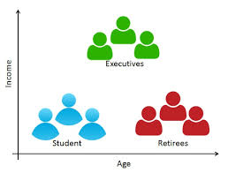
CUSTOMERS’ PURCHASING BEHAVIOUR ANALYSIS
DATA SCIENCE PYTHON FINAL PROJECT:
By: ADEWALE ADEOGUN

Slide 2

Content
Context
Introduction
Goal & Objectives
Business Questions
Research Hypothesis
Data Cleaning & Pre-processing
Data Analysis & Results
Conclusion

Slide 3
- Context
Background
Customers’ Purchasing Behaviour (CPB) is an individual’s buying habits.
CPB are influenced by
Personal,
Psychological and
Social traits
Businesses desires information on:
how customers purchase items,
frequency of purchases,
customers’ product preferences,
plan of marketing strategies &
customer engagement processes.

Slide 4
- Context
Goal
The overarching goal of the study is to demonstrate the application of Data Science methodology to understanding CPB, and its impact on an improvement process of a Company.
Specific Objectives
Generation of insights from the analytical procedure towards understanding the impact of customers’ purchase behaviours on businesses and based on these findings, make recommendations for consideration by the management staff of the client Company; and
Writing of Python codes as a means of implementing technology and algorithm solutions to solve real-life business issues;
Documentation of the study procedure through the development of a project report targeted at technocrats and Powerpoint-slides for presentation to top management staff of the client Company

Slide 5
- Context
Business Questions
What are the drivers of purchases by Customers from the Company?
Who are the major Customers making purchases from the company?
How often does an average Customer purchase items from the Company?
What is the value of item purchased by Customers from the Company?
Research Hypothesis
Null Hypothesis H₀ : All customers do not purchase equally
Alternative Hypothesis H₁: All Customers do purchase equally

Slide 6
Dataset Description
DATA SOURCE:
https://www.kaggle.com/brijbhushannanda1979/bigmart-sales-data
Properties of Dataset
The dataset structure comprised of 1,966 instances (i.e. a row per customer data items) and 48 features (i.e. columns of features on purchase and other related variables). The features were:

Slide 7
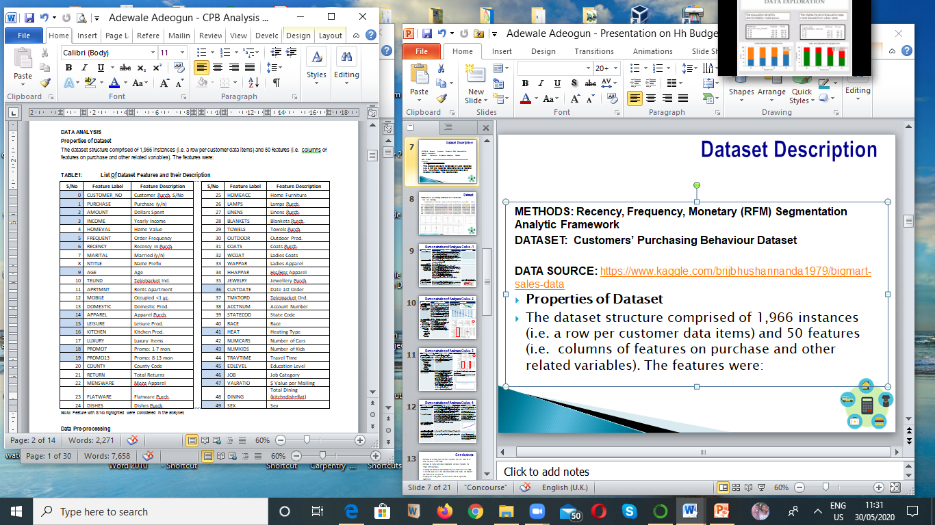
Dataset Description

Slide 8
Dataset Description
Properties of Dataset
Feature slicing was done to reduce the features to 11 for the main analysis

Slide 9
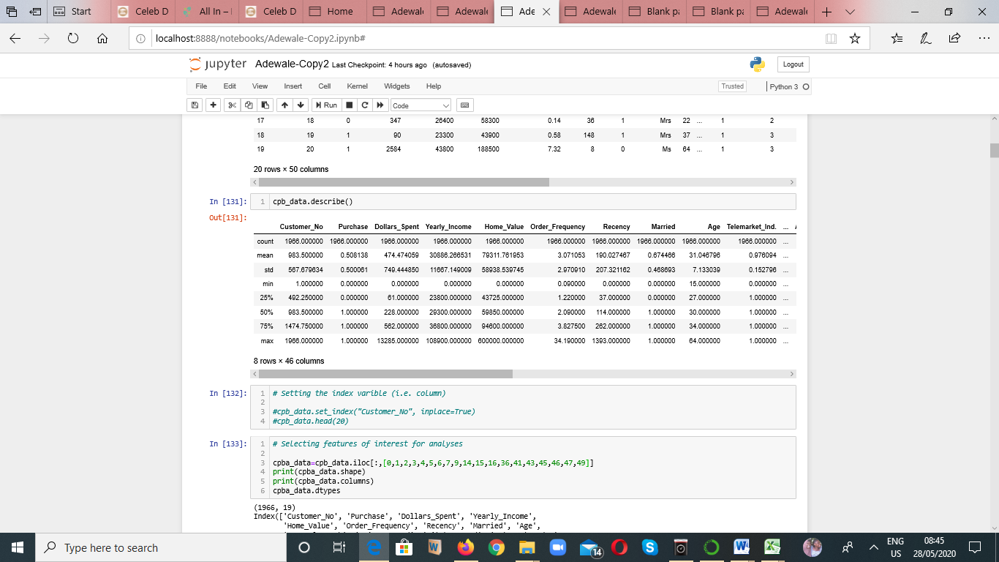
Dataset EDA

Slide 10
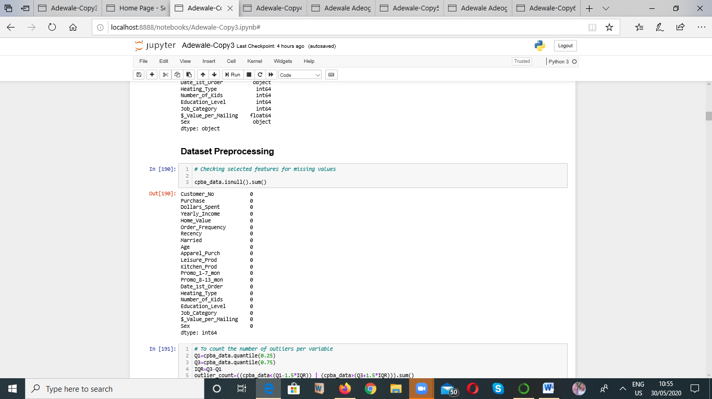
Missing Value Handling

Slide 11

Outlier Detection & Dealing
Outliers were relatively small , compared to the size of records in the dataset, hence they were dropped

Slide 12
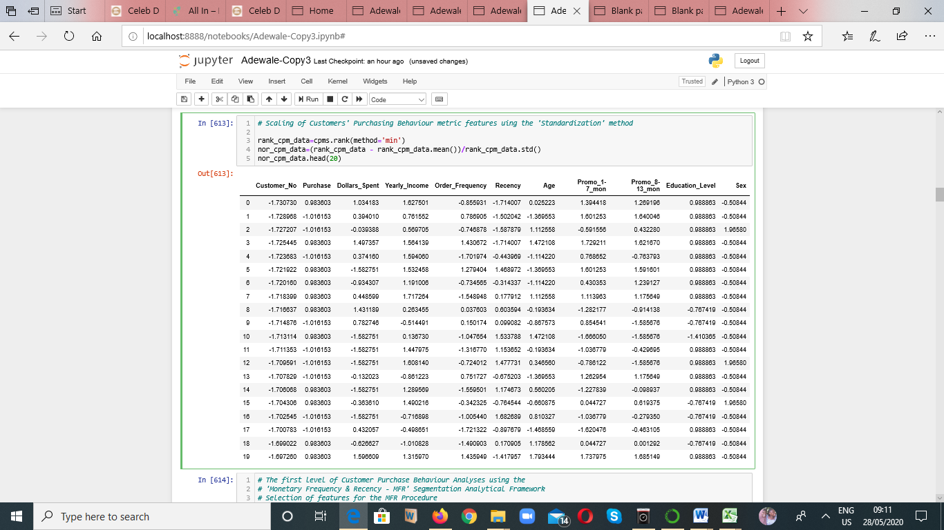
Scaling – Normalization of Features

Slide 13
Analytical Frame Work
1st Level Analysis: Customer Segmentation
Recency
Frequency
Monetary
2nd Level Analysis: RFM segmentation result extrapolated on other Customer Purchase Drivers
Demographic
(Age, Sex)
Economic
(Annual Income,
Sales Promotion)
Social
(Academic level )
Insight & Inference on Category of Customers
Category of Customers
Premium Customers
Opportunity Customers
Least RFM Contributor Customers

Slide 14
Analytical Framework
1st Level Analysis: Customer Segmentation
Recency
Frequency
Monetary
2nd Level Analysis: RFM segmentation result extrapolated on other Customer Purchase Drivers
Demographic
(Age, Sex)
Economic
(Annual Income,
Sales Promotion)
Social
(Academic level )
Insight & Inference on Category of Customers
Category of Customers
Premium Customers
Opportunity Customers
Least RFM Contributor Customers

Slide 15
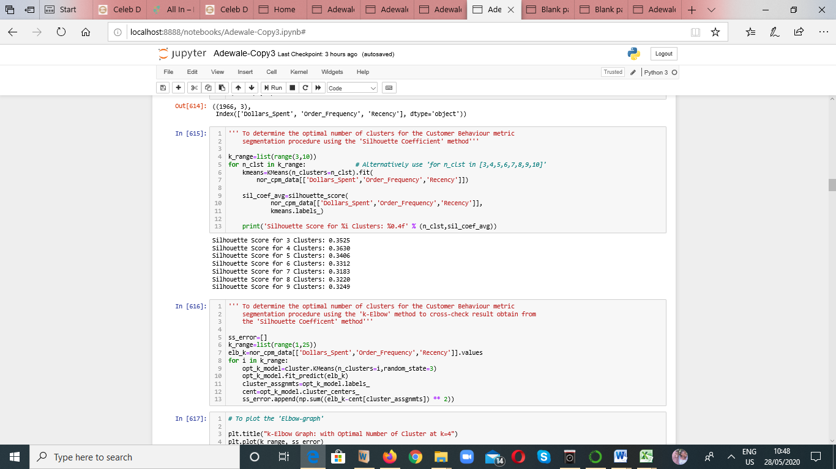
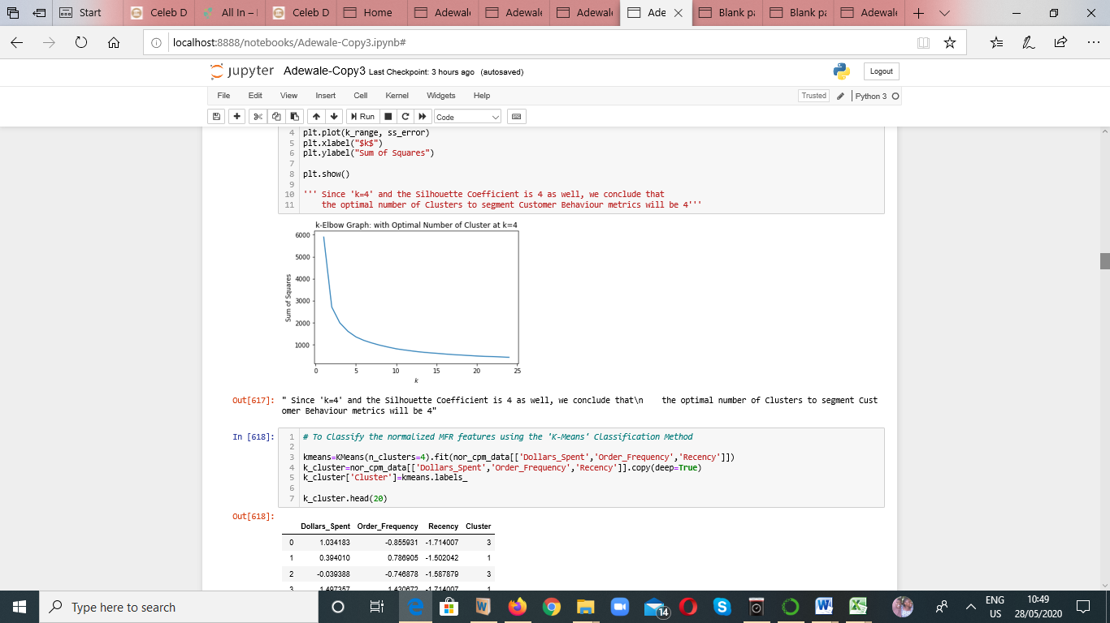
1st Level of Analysis – Customer Segmentation
RFM Segmentation Analysis Variables:
Recency, Order Frequency, Dollars_Spent
The ‘Silhouette Coefficient’ and ‘k-Elbow Graph Results where k = 4.

Slide 16
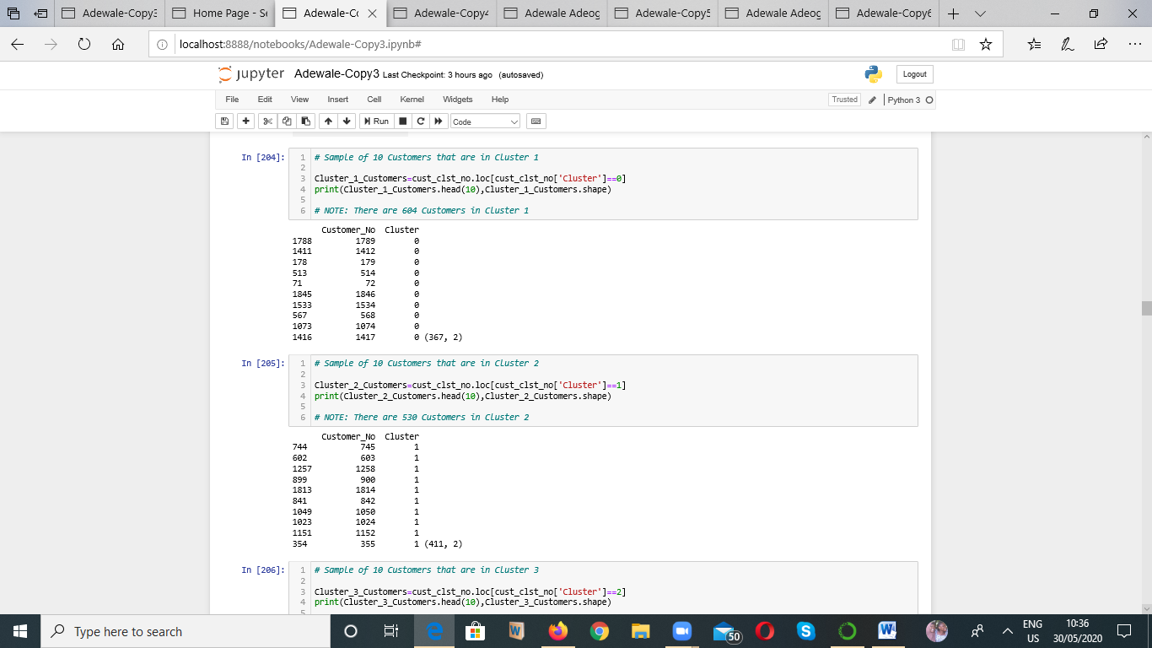
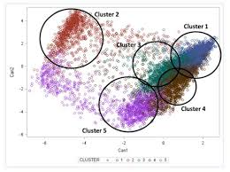
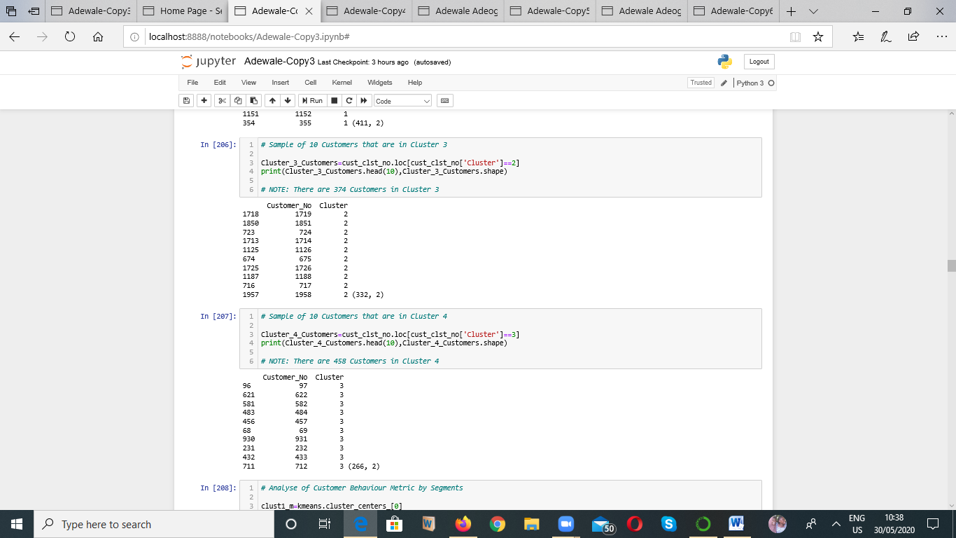
1st Level of Analysis – Customer Segmentation

Slide 17
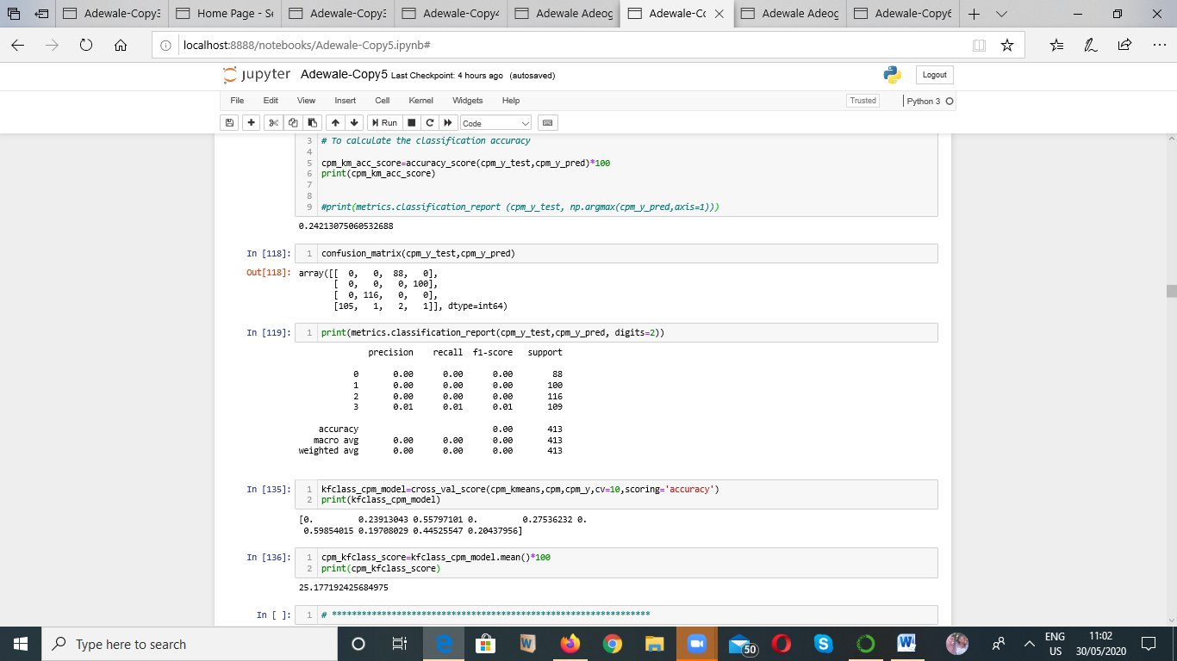
1st Level of Analysis – Model Evaluation
Model Evaluation

Slide 18
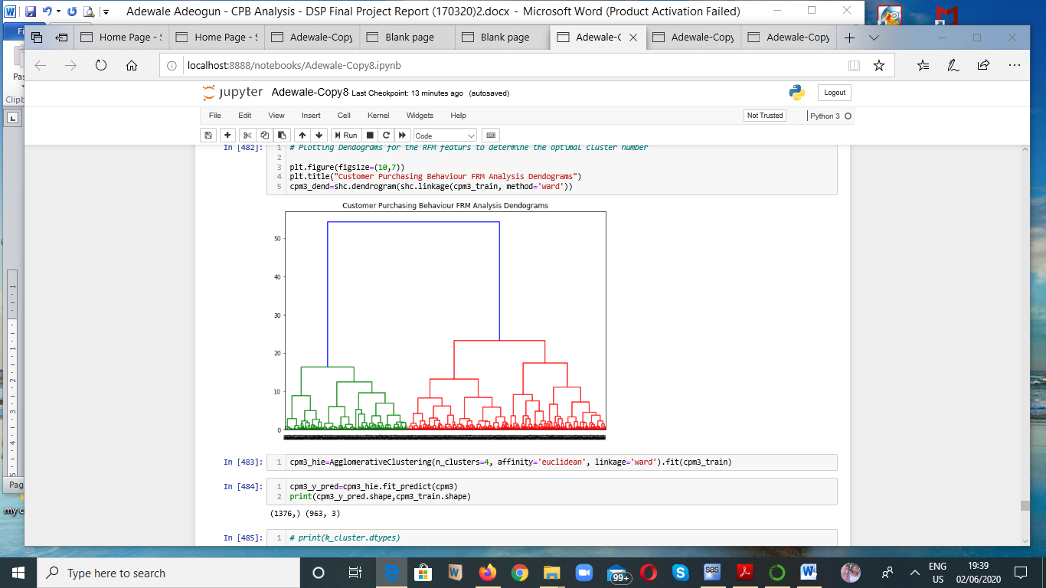
1st Level of Analysis – Model Evaluation
Hierarchical Clustering Model - Dendograms

Slide 19
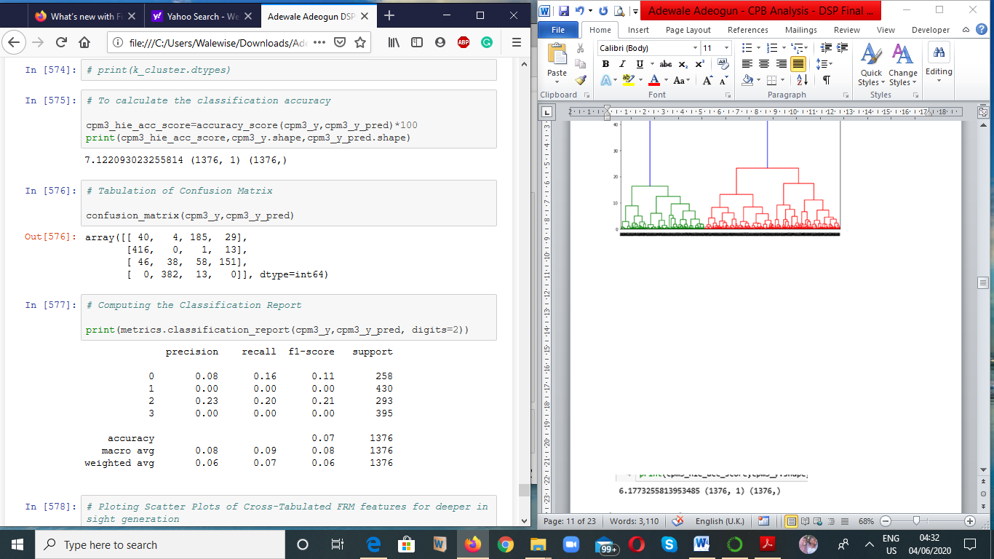
1st Level of Analysis – Model Evaluation
Hierarchical Clustering Model

Slide 20
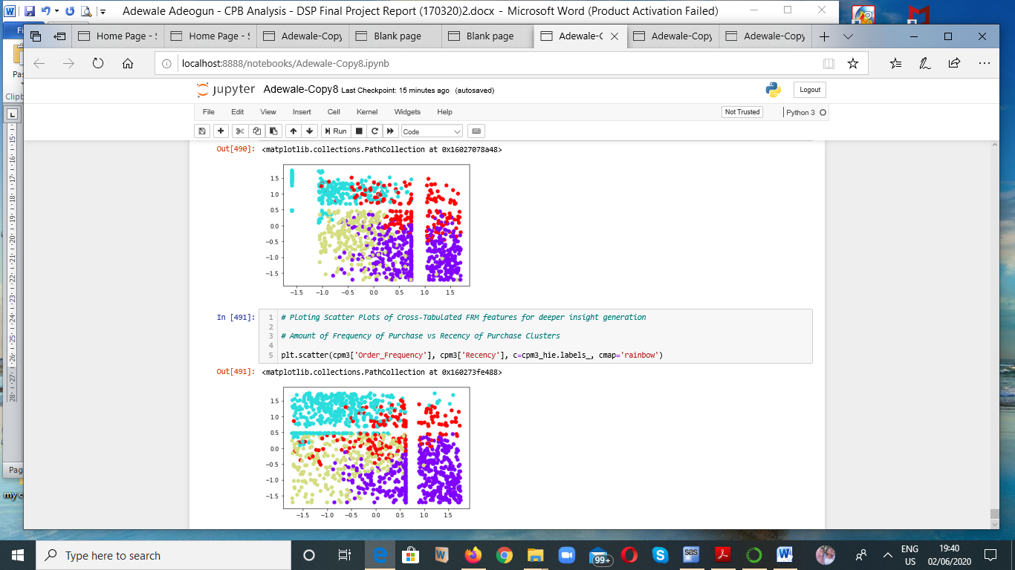
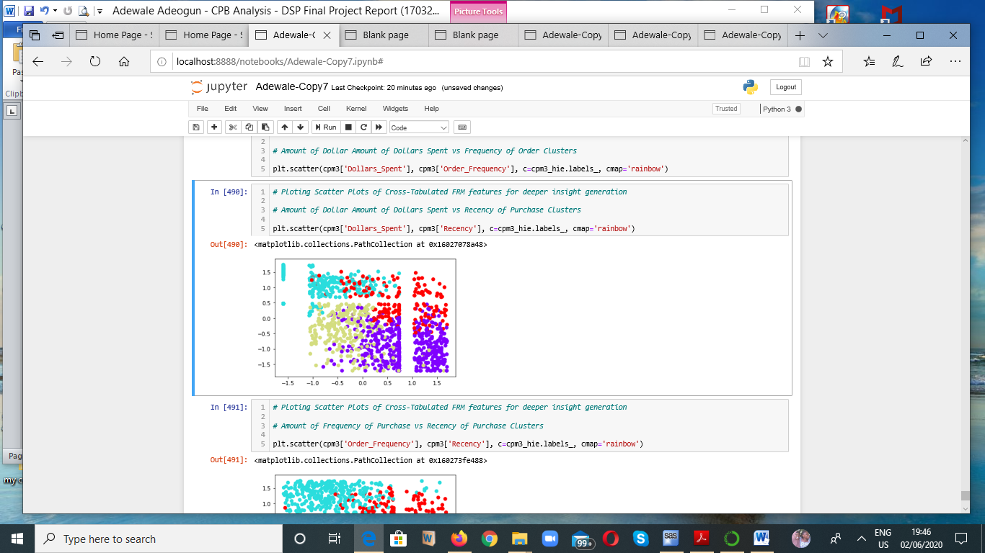
1st Level of Analysis – Model Evaluation
Hierarchical Clustering Model
Dollar Spent vs Recency of Order
Dollar Spent vs Order Frequency
Frequency of Order vs Recency of Order

Slide 21
1st Level of Analysis – Model Evaluation
SUMMARY: ALL MODELS’ PERFORMANCE COMPARISON MATRIX
Analysis Variables:
Response: Purchase (Yes or No)
Predictors: Recency, Order Frequency, Dollars_Spent
S/No | Model Type | Accuracy Score
1. | K-Mean | 42.2%
2. | Hierarchical Clustering | 7.14%

Slide 22
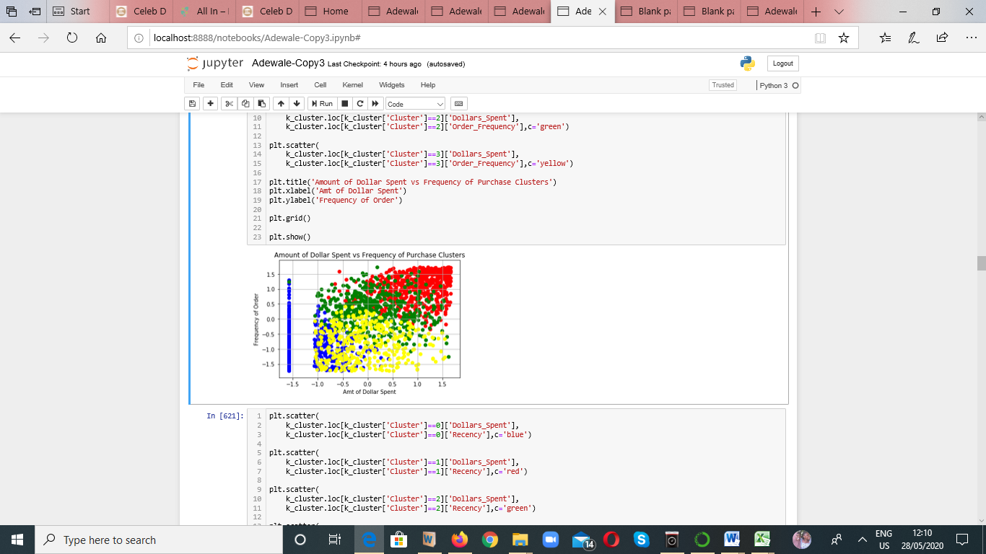
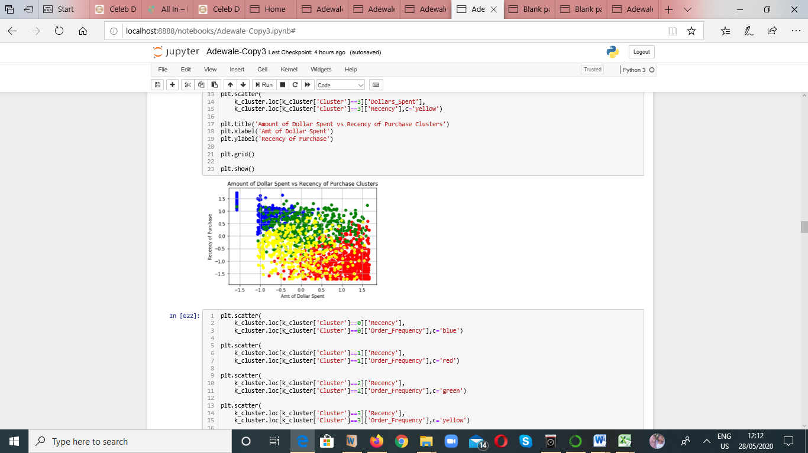
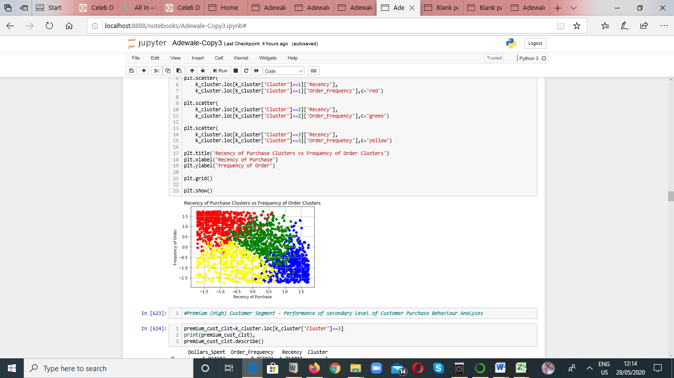
1st Level of Analysis – Customer Segmentation
A
B
Interpretation of Result of C
Customers in Cluster (Blue) - High Recency of Purchase and Low Frequency of Order
Customers in Cluster (Red) - High Recency of Purchase and Low Frequency of Order
Customers in Cluster (Green) - Moderate Recency of Purchase and Moderate Frequency of Order
Customers in Cluster (Yellow) - Low to Moderate Recency of Purchase and Low to Moderate Frequency of Order
C

Slide 23
1st Level of Analysis – Customer Segmentation
Summary
BLUE: 4 Lows and 2 Highs - hence classified as
Moderate (Opportunity) Class or Segment
RED: 2 Lows and 4 Highs - hence classified a
High (Premium) Class or Segment
GREEN: 6 Moderates - hence classified as
Moderate (Opportunity) Class or Segment
YELLOW: 5 Lows and 1 Moderate hence classified as
Low (Least RFM contributor) Class or Segment

Slide 24
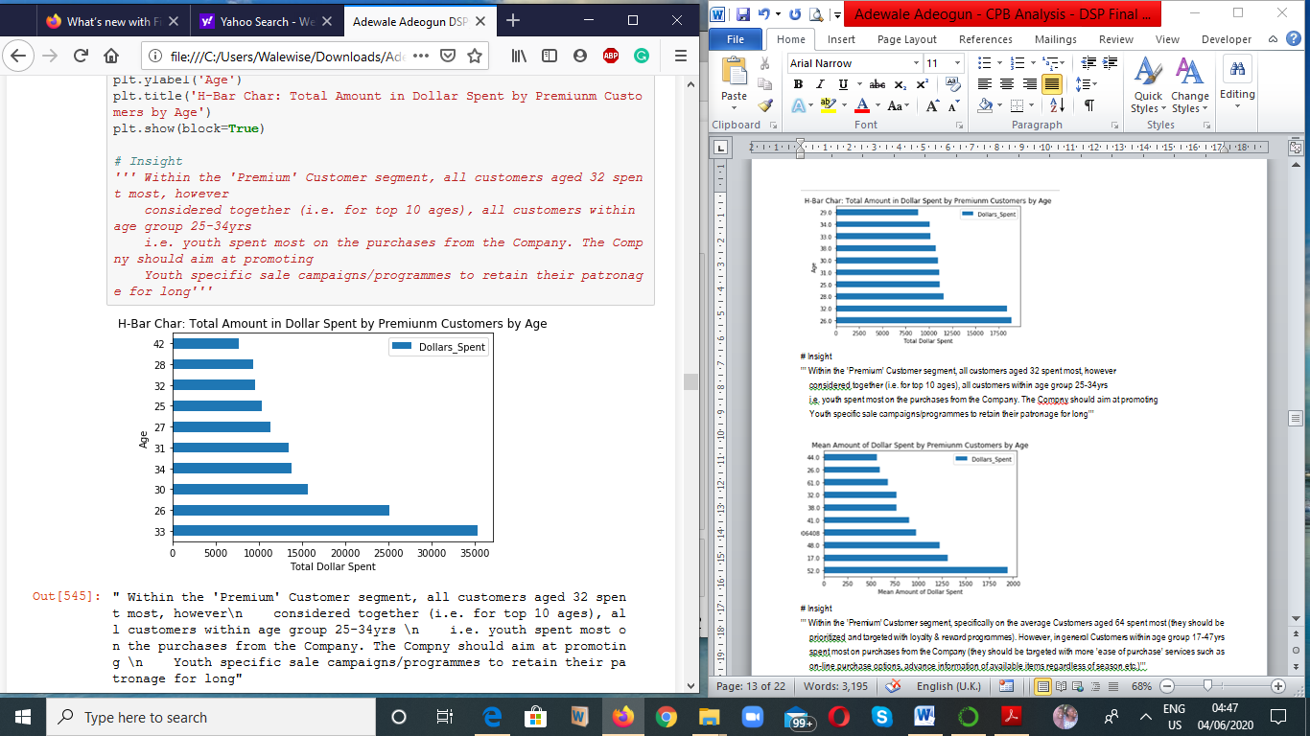
2nd Level of Analysis – EDA & Cross-tabulation
Premium Customer Group
Insight
Customers aged 32 in absolute (total) value, were the highest spender.
If however it is considered for top 10 ages, customers within age group 25-34yrs i.e. youths were highest spender on purchases from the Company.
Recommendation:
The Company should therefore aim at promoting Youth specific sale campaigns /programmes to retain their patronage and interests for a very long time.

Slide 25
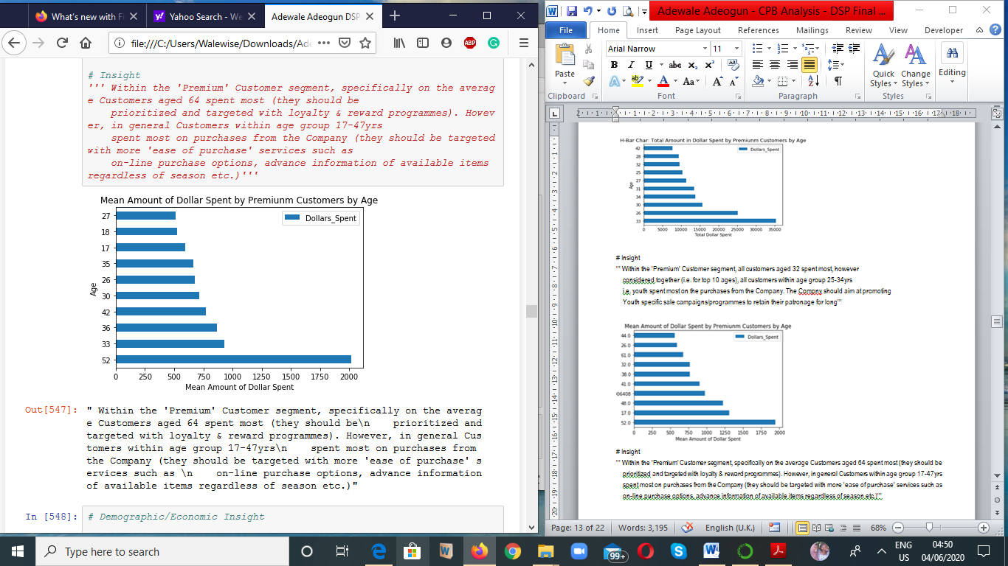
2nd Level of Analysis – EDA & Cross-tabulation
Premium Customer Group
Insight
On the average (in larger numbers) Customers aged 52 spent most on purchases, hence they should be prioritized and targeted with loyalty & reward programmes.
However, for top 10 ages Customers within age group 17-52yrs on the average spent most on purchases from the Company.
Recommendation:
The Company should be targeted with more 'ease of purchase' services such as on-line purchase options, advance information of available items regardless of season etc.

Slide 26
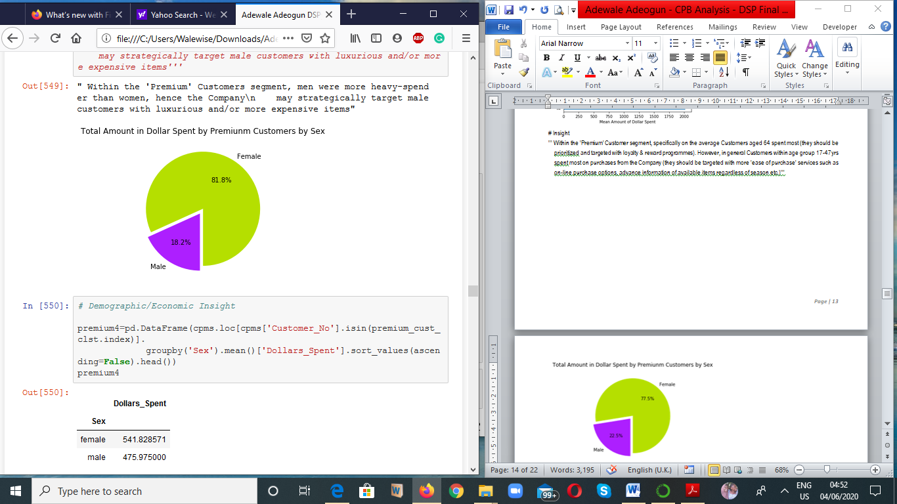
2nd Level of Analysis – EDA & Cross-tabulation
Premium Customer Group
Insight & Recommendations
Within the 'Premium' Customers segment, in absolute value females were more heavy-spender than male customers, hence the Company should strategically target female customers with luxurious and/or more expensive items.

Slide 27
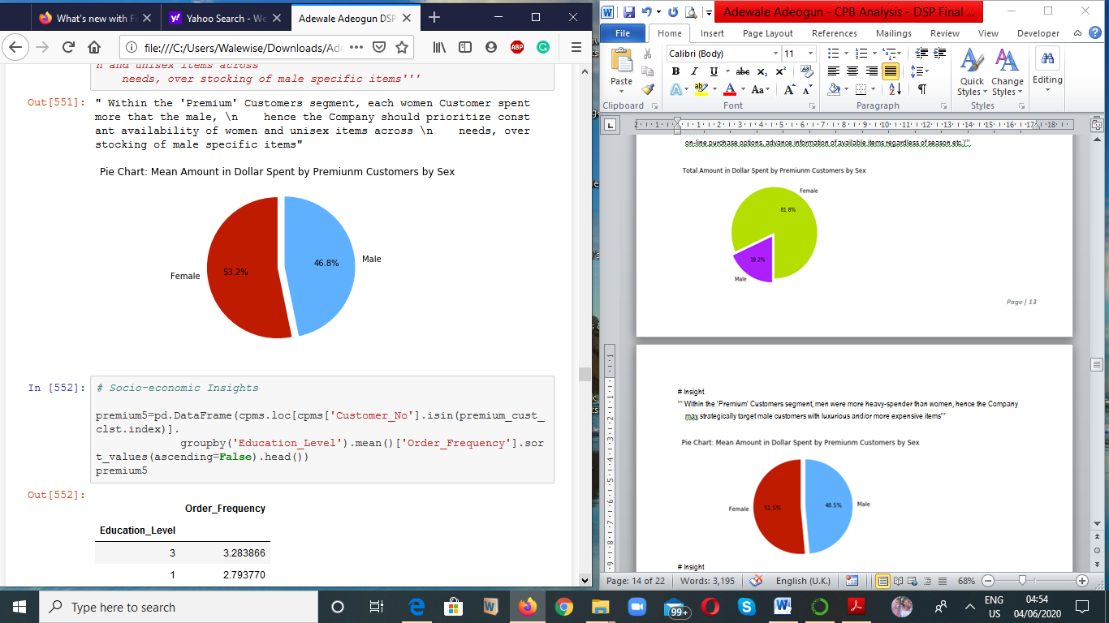
2nd Level of Analysis – EDA & Cross-tabulation
Premium Customer Group
Insight & Recommendations
Within the 'Premium' Customers segment, on the average (in more numbers) each female customers spent more than the male, hence the Company should prioritize constant availability of women and unisex items across needs, over stocking of male specific items.

Slide 28
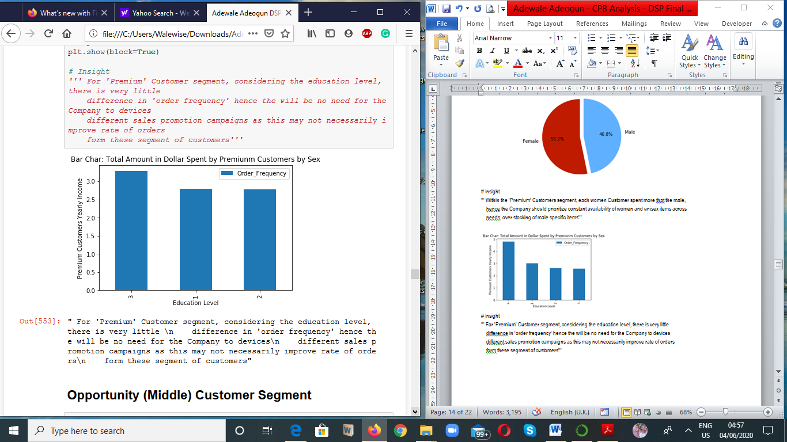
2nd Level of Analysis – EDA & Cross-tabulation
Premium Customer Group
Insight
For 'Premium' Customer segment, considering the education level, there was very little difference in 'order frequency'
Recommendations
There will be no need for the Company to devices different sales promotion campaigns as this may not necessarily improve rate of orders from these segment of customers'''

Slide 29
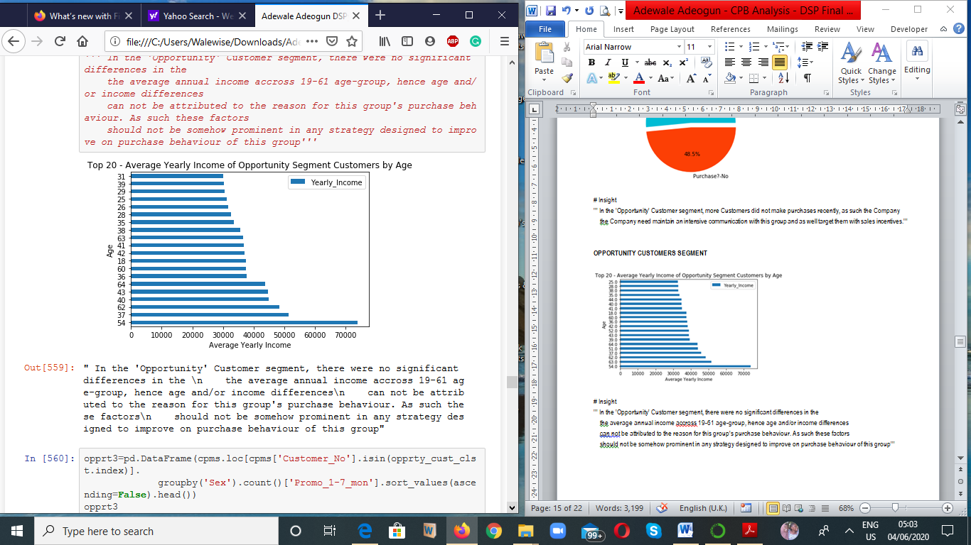
2nd Level of Analysis – EDA & Cross-tabulation
Opportunity Customer Group
Insight & Recommendations:
In the 'Opportunity' Customer segment, there were no significant differences in the average annual income across 19-61 age-group, hence age and/or income differences cannot be attributed to the reason for this group's purchase behaviour. As such these factors should not be somehow prominent in any strategy designed to improve on purchase behaviour of this group.'

Slide 30
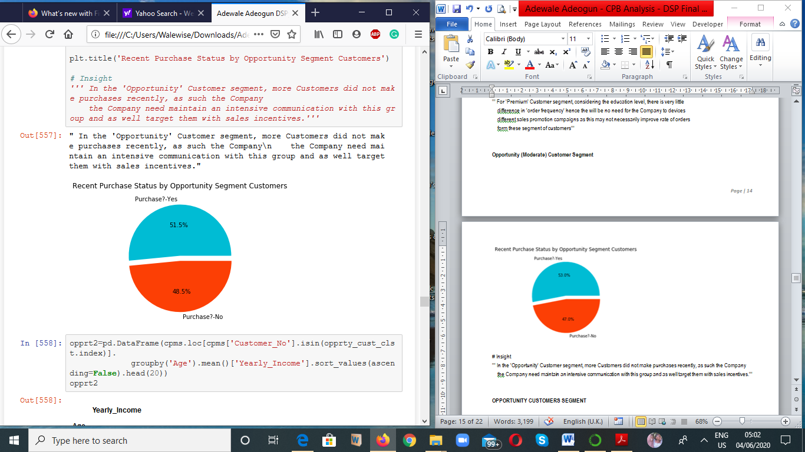
2nd Level of Analysis – EDA & Cross-tabulation
Opportunity Customer Group
Insight & Recommendations
In the 'Opportunity' Customer segment, many Customers did not make purchases recently, as such the Company the Company need maintain an intensive communication with this group and as well target them with sales incentives.’

Slide 31
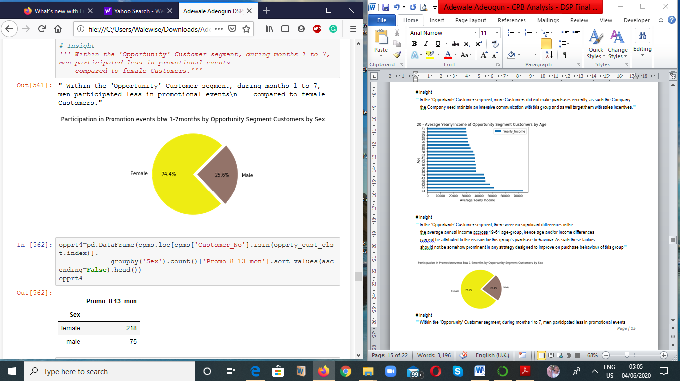
2nd Level of Analysis – EDA & Cross-tabulation
Opportunity Customer Group
Insight & Recommendations
Within the 'Opportunity' Customer segment, during months 1 to 7, many more females participated in promotional events compared to female Customers.

Slide 32
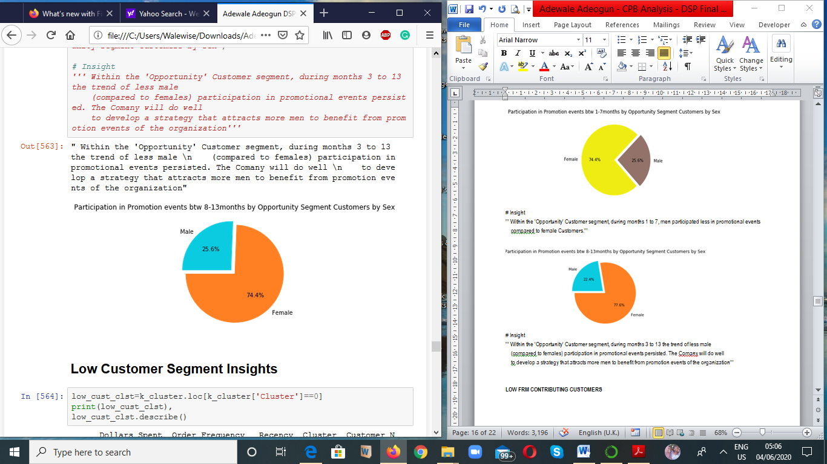
2nd Level of Analysis – EDA & Cross-tabulation
Opportunity Customer Group
Insight & Recommendations
Within the 'Opportunity' Customer segment, during months 8 to 13 the trend of less male (compared to females) participation in promotional events persisted. The Company will do well to develop a strategy that attracts male customers to benefit from promotion events of the organization

Slide 33
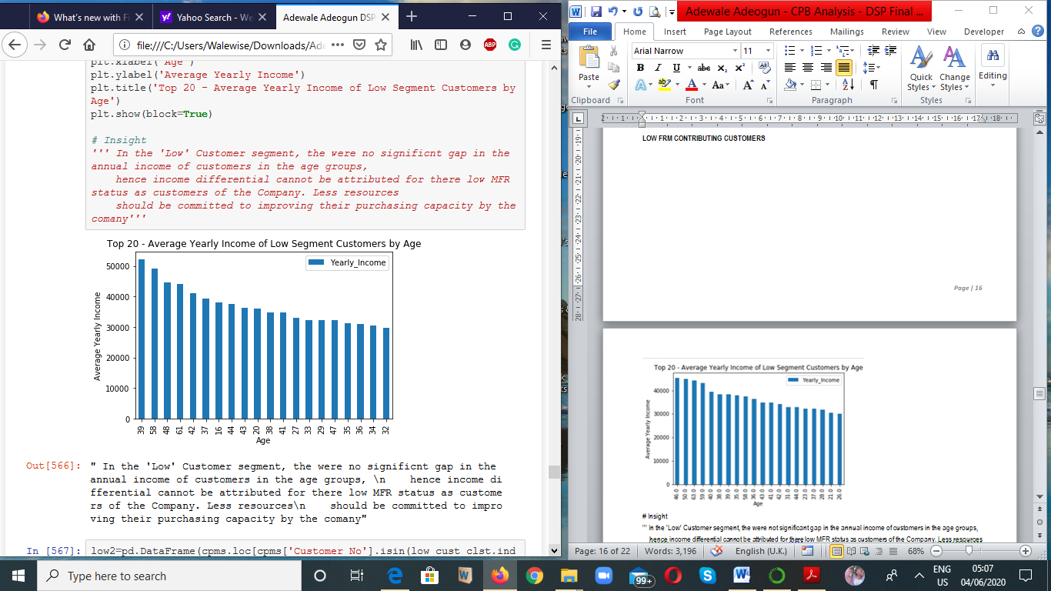
2nd Level of Analysis – EDA & Cross-tabulation
Low RFM Contributor Customer Group
Insight
In the 'Low' Customer segment, the were insignificant gap in the annual income of customers in the age groups, hence income differential cannot be attributed for these low RFM status as customers of the Company.
Recommendations
Less resources should be committed to improving their purchasing capacity by the company

Slide 34
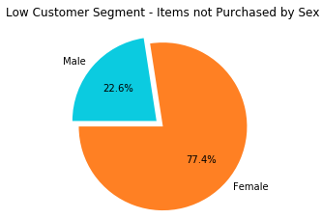
2nd Level of Analysis – EDA & Cross-tabulation
Low FRM Contributor Customer Group
Insight & Recommendations
In the 'Low' Customer segment, there were more Female customers during not purchasing compared to male customers. The Company will do well to develop an inexpensive (commit little or no resources) strategies that would attract more women to purchase from the Company.

Slide 35
THANK YOU

